Slide 1


2023 Call for code
-- Water quality optimizer
August 2023
Smart water source

Slide 2
directory
01
Background
02
Initial work
03
Creative introduction

Slide 3
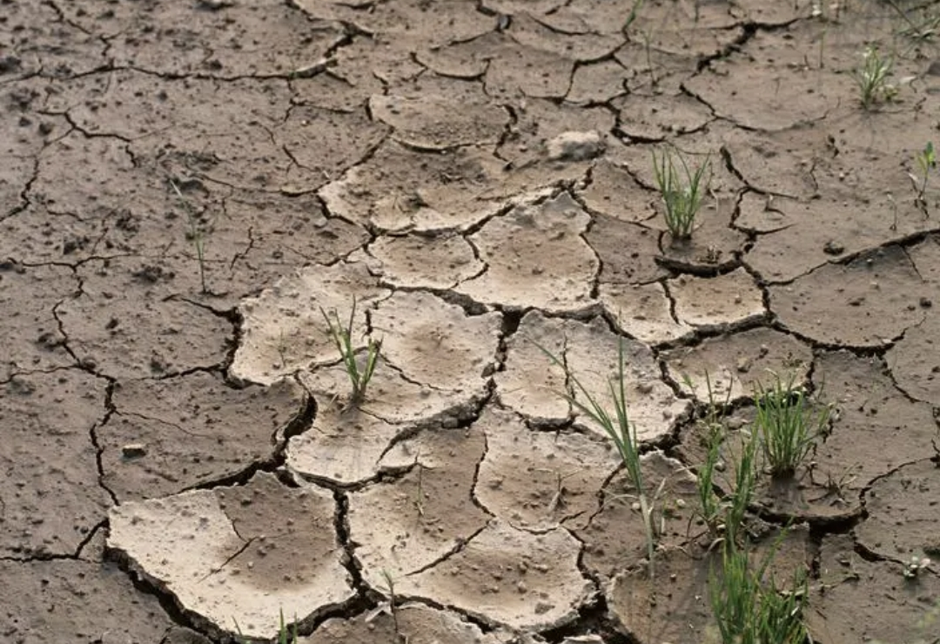
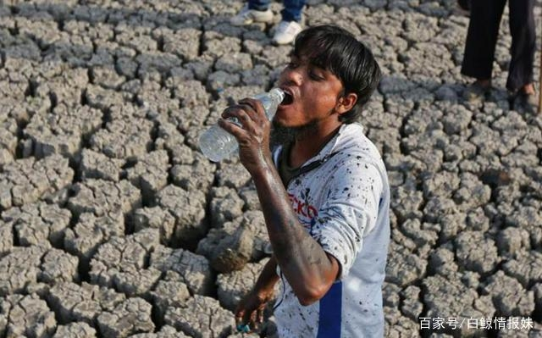
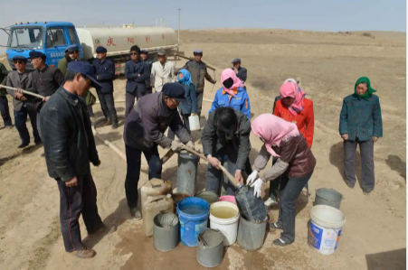
Background
According to the 2023 United Nations World Water Development Report, about 1/4 of the global population is facing a crisis of "extreme water scarcity".
According to a United Nations survey of water resources in 189 countries and regions worldwide, over 1 billion people currently live in water scarce areas, with up to 3.5 billion people facing water scarcity by 2025. Seventeen countries and regions consume more than 80% of their total available water resources annually.

Slide 4
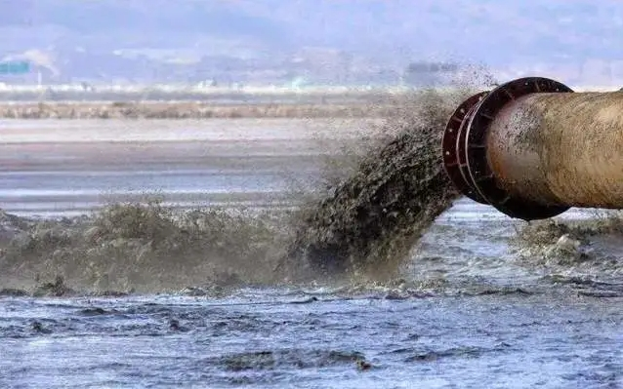
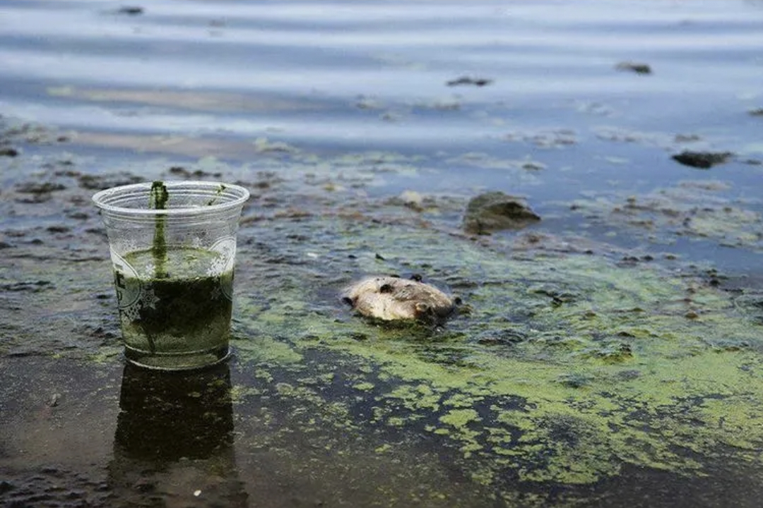
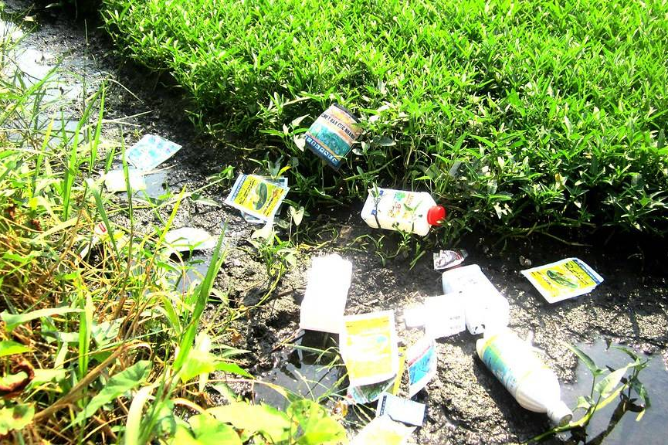
Background
The report shows that 26% of the world's population (2 billion people) do not have clean drinking water, and 46% of the population lacks basic sanitation facilities.
On average, 80% of wastewater in the world is discharged into the ecological environment without any treatment, and in some developing countries, this proportion can even reach as high as 99%.

Slide 5
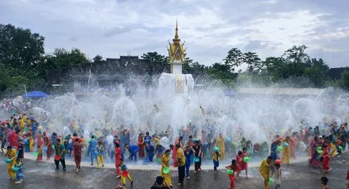
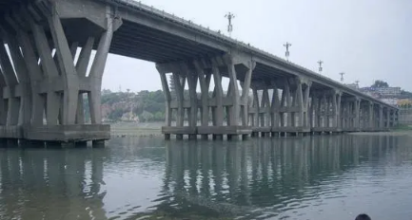
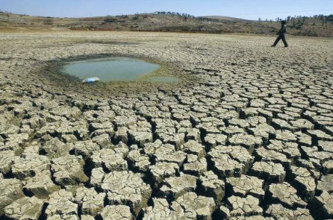
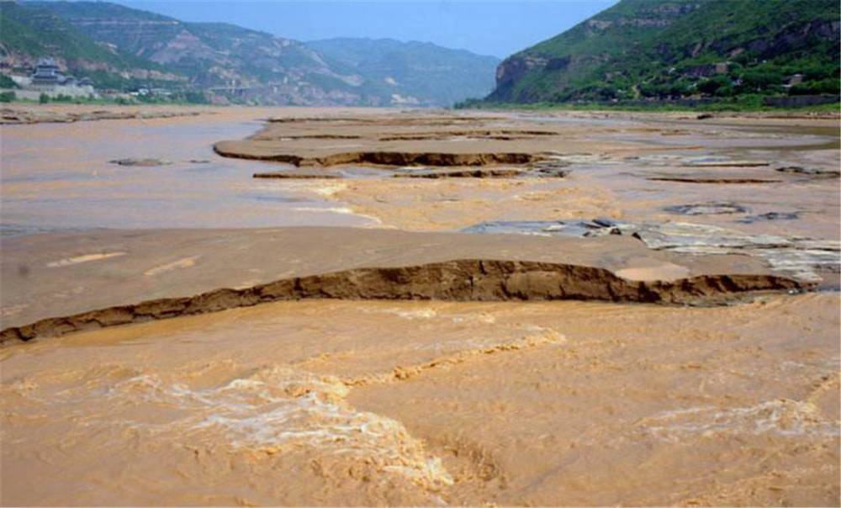
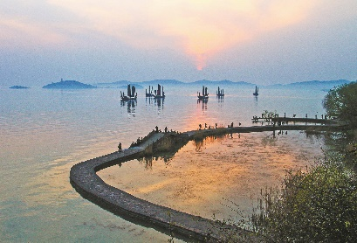
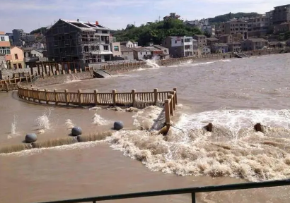
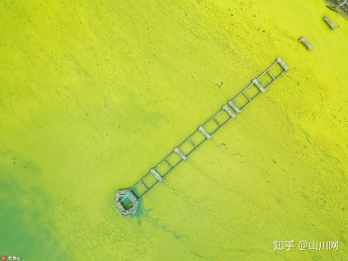
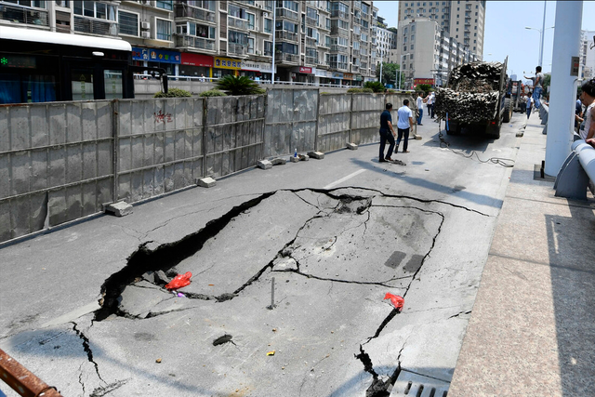
Background
Global water resources are unevenly distributed
Water causes environmental change
Global water quality pollution
Water-induced secondary disasters

Slide 6
directory
01
Background
02
Initial work
03
Creative introduction

Slide 7
Initial work
Analysis of water quality treatment experience
Collect water quality treatment cases from around the world, analyze the causes and solutions of water quality problems, and establish a reference database.

Slide 8
Initial work
2. Indicators on water quality issues
Analyze a number of water quality indicators and select the 8 indicators that are most suitable for displaying and analyzing water quality problems.

Slide 9
Initial work
3. Build an overall database
Collect water quality data on chemical oxygen demand, dissolved oxygen, dissolved total organic carbon, pH, phosphate, silicate, total nitrogen, and total phosphorus, establish water quality databases. And collect case data on successful treatment of water quality problems, establish reference databases.

Slide 10
directory
01
Background
02
Initial work
03
Creative introduction

Slide 11
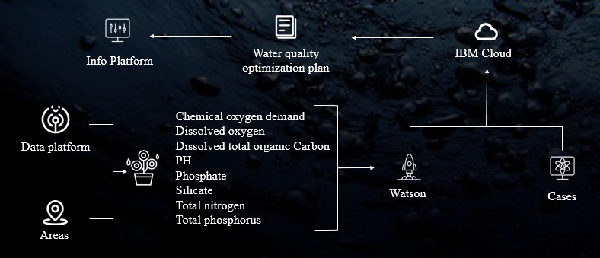
Architecture design

Slide 12
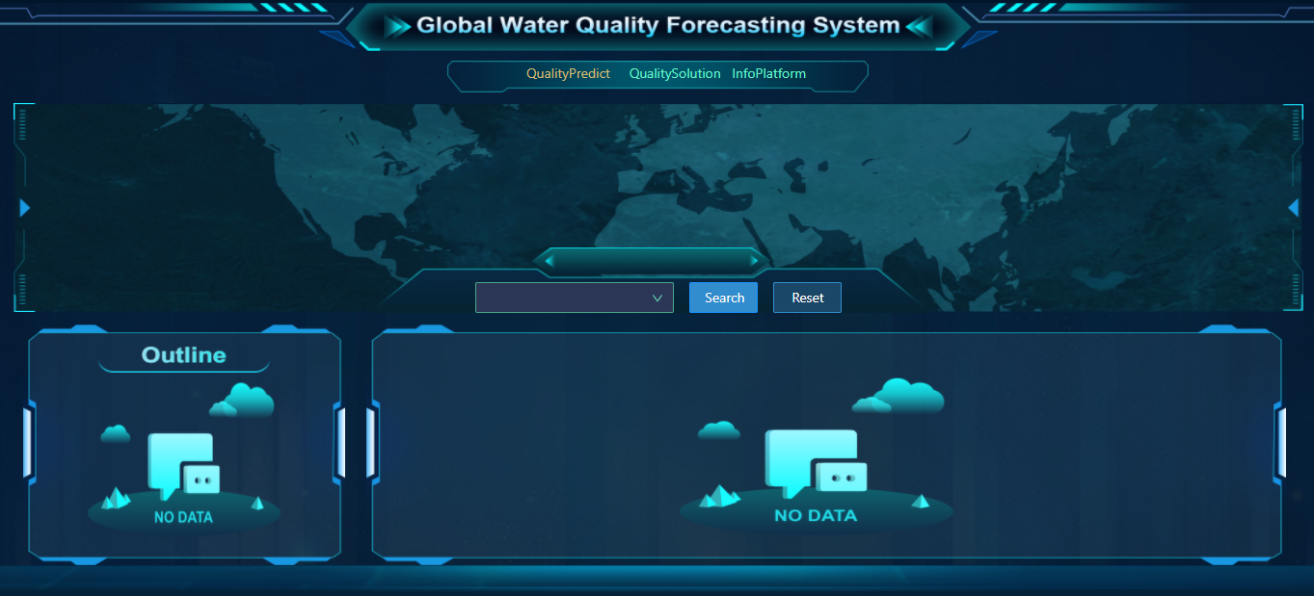
Page Design

Slide 13
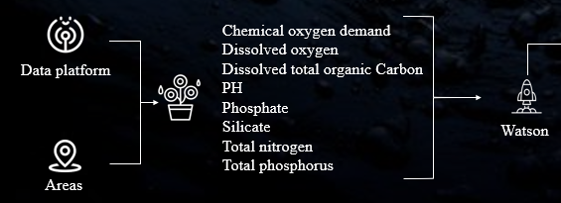
Architecture design
Firstly, we can select an area and then obtain historical water quality data for the specified area from the data platform, We take into account various indicators such as chemical oxygen demand, dissolved oxygen, dissolved total organic carbon, pH, phosphate, silicate, total nitrogen, and total phosphorus, which affect water quality. We train the model using IBM Watson to achieve water quality prediction.

Slide 14
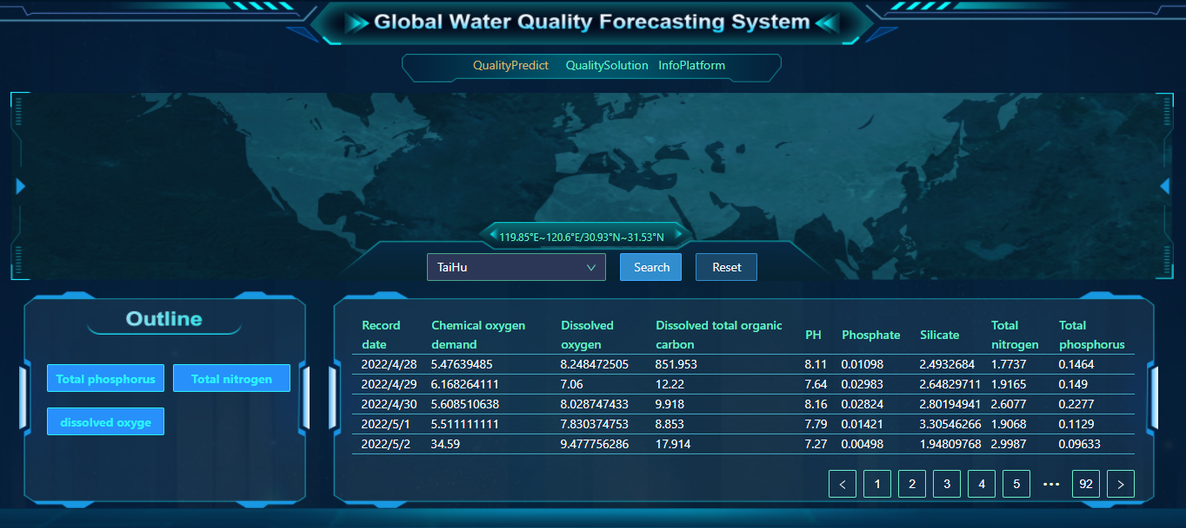
Page Design

Slide 15
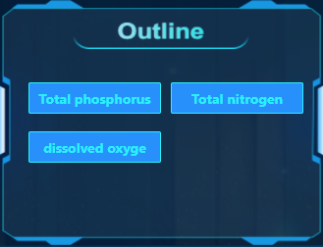
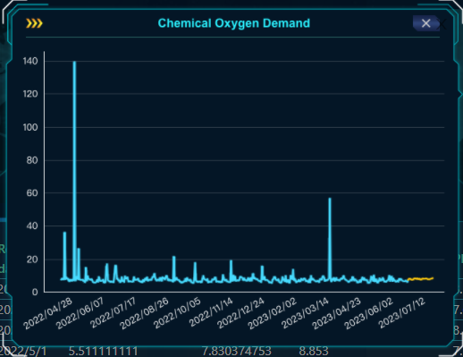
Page Design
We determine the water quality of the water area based on the model prediction data and display abnormal indicator items.
We can click on the indicator item name to view the trend chart of the data，The blue color of this curve represents historical data and the yellow color represents predicted data.

Slide 16
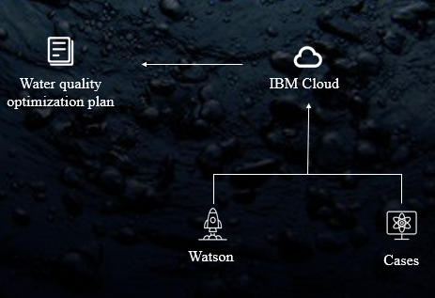
Architecture design
Based on the predicted data of the model, determine the water quality issues in the region and combine with successful cases of water quality control in other regions of the world to clarify the water quality optimization plan.

Slide 17
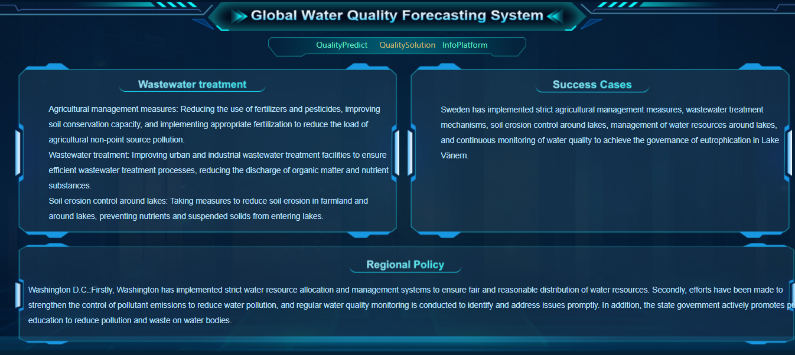
Page Design

Slide 18
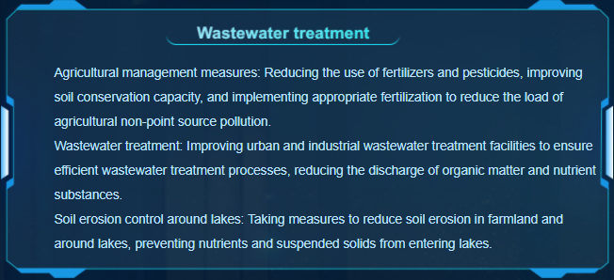
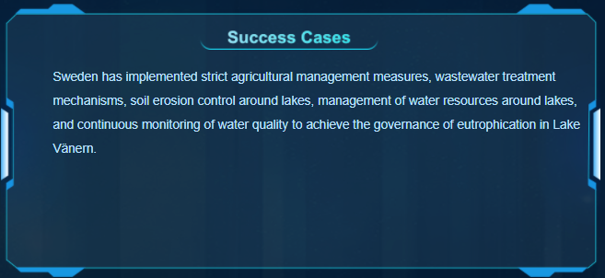
Page Design
We recommend a reasonable water quality optimization plan based on successful cases of water quality optimization in the world, and then present the corresponding successful cases as a reference

Slide 19
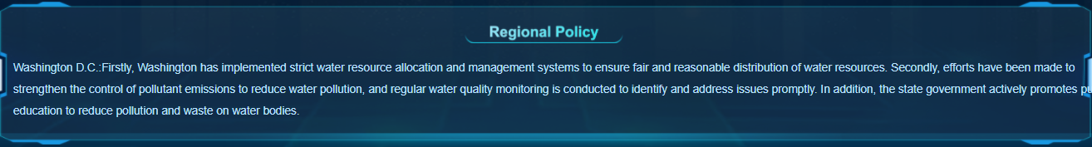
Page Design
At present, policies on water environment governance vary in different regions of the world, so we need to consider rolling broadcasts of corresponding policies for different countries and regions.

Slide 20
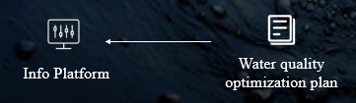
Architecture design
we provide an information platform where users can publish inquiries seeking help for improving water quality. Professionals can provide constructive suggestions for regional water quality improvement through this platform.

Slide 21
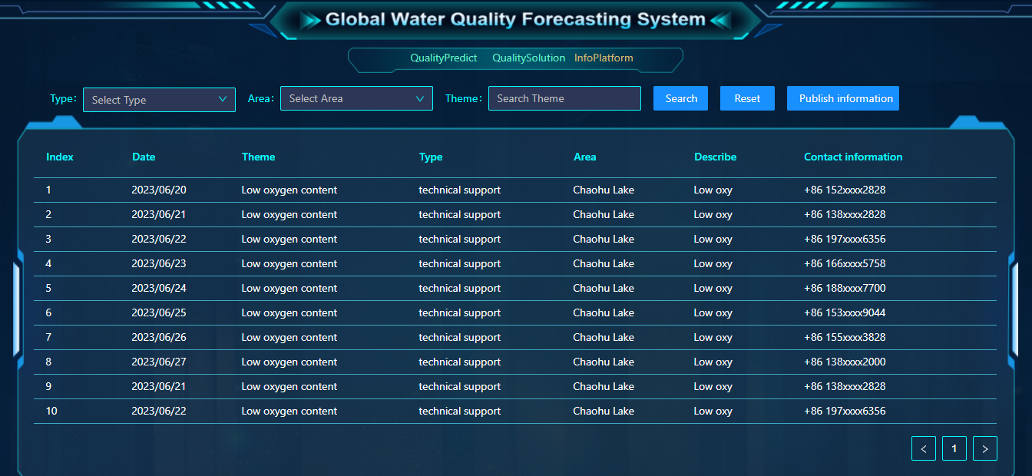
Page Design

Slide 22
Social value
Establish a global water quality management platform, provide timely water resources information, and provide general solutions to water quality problems to help maintain global water resources
By collecting and disseminating water quality data and solutions on a global scale, the Water Quality Information Platform can provide a powerful reference for governments, environmental protection organizations and relevant decision-makers. This helps improve policy, regulation and management to ensure better water quality and sustainability.

Slide 23
Social value
Integrating technical and commercial resources, an open platform has been established to provide all people or organizations who want to help solve water quality problems with channels for communication and docking with areas with water quality problems, so that poor areas can get more help.
Cross-border cooperation can be strengthened, partnerships and cooperation can be strengthened in all regions of the world, and different models and results of cooperation on water quality governance can be explored.

Slide 24
Follow-up work
In the follow-up, the function of providing general water quality treatment solutions based on water quality data will be further improved, and through IBM AI, targeted water quality treatment solutions will be provided for decision-makers to refer to according to local unique natural environment, economy, policies and other factors.

Slide 25
Thanks

